Slide 1
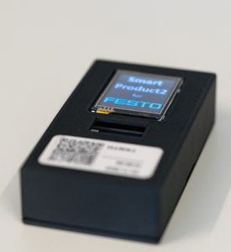

12 SLIDES · 15 MIN · 06/2026
Circular Economy Concept for an Industry 5.0 Demonstrator.
A working factory simulation that routes every component to Reuse, Refurbish, or Recycle — closing the linear loop, by design.
PROJECT Circular Economy · Industry 5.0 Demonstrator
LEAD Denis Gabriela L. Esquivel
TEAM Favour Atem · Barbara Calderón · Anshpreet Singh
Marko A. García · Diego Cárdenas
01 / 12

Slide 2
02 · TABLE OF CONTENTS · 15 MIN TALK
· 02/12
ROADMAP · FOUR SECTIONS · TEN MINUTES
From planning, through risk, to a working loop.
01
02
Project Approach
Risk Discipline
The gap, the goal, and the Agile structure that made delivery possible on a short timeline.
Five FMEA risks, the highest at RPN 336 — and the corrective actions that cut every one by 53–86%.
SLIDES 03 · 04
SLIDES 05 · 06
03
Components & Test Method
04
The Working System
13 components classified into Reuse / Refurbish / Recycle, each certified non-destructively at one of four real test stations.
Closed-loop architecture, the measured 62.5% baseline on 24 process steps, and the Tecnomatix demonstrator running it.
SLIDES 07 · 08
SLIDES 09 · 10 · 11
SLIDE 02 / 12

Slide 3
03 · SECTION 01 OF 04 · PROJECT APPROACH · GAP & GOAL
· 03/12
THE GAP · THE GOAL · FIVE PRINCIPLES
The line was linear — and that's the part we set out to break.
STARTING POINT · THE GAP
TARGET STATE · THE GOAL
Take. Make. Dispose.
Recover. Re-test. Re-integrate.
An automated assembly and disassembly system operating as a linear process. No established technical method to validate, track, or re-integrate used components.
A Circular Economy Technical Demonstrator built on the same IoT line — five operating principles that make the loop close.
✕ Functional components routed to scrap
✕ No traceability of cycle count or origin
✕ Material value lost at end-of-life
✕ Incompatible with Industry 5.0 mandate
01 Structure products for non-destructive separation
02 Define technical criteria to certify a used part
03 Decide when refurbish beats a new part on time/cost
04 Track component history through production data
05 Demonstrate the closed loop end-to-end
SLIDE 03 / 12

Slide 4
04 · SECTION 01 OF 04 · PROJECT APPROACH · STRUCTURE
· 04/12
AGILE STRUCTURE · BI‑WEEKLY SPRINTS · CLEAR ROLES
We ran the project the way we'd run the factory.
Agile cadence · explicit roles · iterative prototyping with the available lab Data · a timeline that composed of 7 days sprint sessions.
01 · CADENCE
02 · ROLES
03 · TIMELINE
Bi-weekly sprints
Six-person team
3*7 day sprints
Progress reviews every two weeks to check milestones, clear bottlenecks, and verify subsystem integration before the next sprint.
LEAD Denis Gabriela L. Esquivel
IND ENG Barbara Calderón
SCRUM Diego Cárdenas
IND ENG Marko A. García
SCRUM Favour Atem ·
IND ENG Anshpreet Singh
Facility & process kickoff
Component tracking research
Lifecycle classification matrix
Demonstrator review
PREVENTS Linear phase-gate trap on a short timeline
THE METHODOLOGICAL TURN
limited physical factory access → built a concept virtual twin of the IoT-factory using Factory data .
SLIDE 04 / 12

Slide 5
05 · SECTION 02 OF 04 · RISK DISCIPLINE · FMEA BEFORE
· 05/12
RISK DISCIPLINE · FMEA REGISTER \ HEATMAP
Five risks. Four above the action threshold. One at RPN 336.
Occurrence (W) × Severity (T) × Detection (E). RPN > 100 requires corrective action before the demonstrator is built.
RISK ITEM
W
T
E
RPN
RPN HEATMAP · 1–1000
Process Development & Human Factors
Disassembly lacks shop-floor reality
6
7
8
336
The risk picture, before.
Component Identification & Tracking
Sticker barcodes lost during runtime
6
8
6
288
HIGH RPN > 100 · ACT NOW → 4 of 5 risks
MED RPN 40–100 · MONITOR → 1 of 5 risks
Lifecycle Classification (3Rs)
Scrap-vs-3R sorting without thresholds
5
8
7
280
LOW RPN < 40 · ACCEPT → 0 of 5 risks
Project Launch & Scope
Complexity vs. short timeline
8
7
5
280
1,248
Facility Alignment & Process Mapping
No on-site audit possible
2
8
4
64
TOTAL RPN BEFORE CORRECTIVE ACTION
SLIDE 05 / 12

Slide 6
06 · SECTION 02 OF 04 · RISK DISCIPLINE · FMEA AFTER
· 06/12
RISK DISCIPLINE · CORRECTIVE ACTIONS APPLIED
Every blocking risk now sits below RPN 75 — a 53–86% reduction.
Before vs. after Risk Priority Number for the 5 critical project risks, ranked by improvement %.
RISK ITEM
■ BEFORE ■ AFTER ─ ACTION THRESHOLD = 100
IMPROVEMENT
Project Launch & Scope
Complexity vs. short timeline
RPN 100
280
40
85.7% ↓
Process Development & Human Factors
Disassembly lacks shop-floor reality
336
82.1% ↓
60
Component Identification & Tracking
Sticker barcodes lost during runtime
288
79.2% ↓
60
Lifecycle Classification (3Rs)
Scrap-vs-3R sorting without thresholds
280
73.2% ↓
75
Facility Alignment & Process Mapping
No on-site audit possible
64
53.1% ↓
30
METHOD RPN = Occurrence (W) × Severity (T) × Detection (E) · corrective actions completed 03–20/06/2026
SLIDE 06 / 12

Slide 7
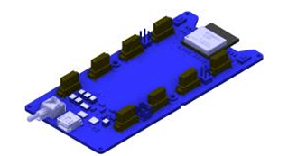


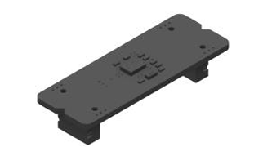

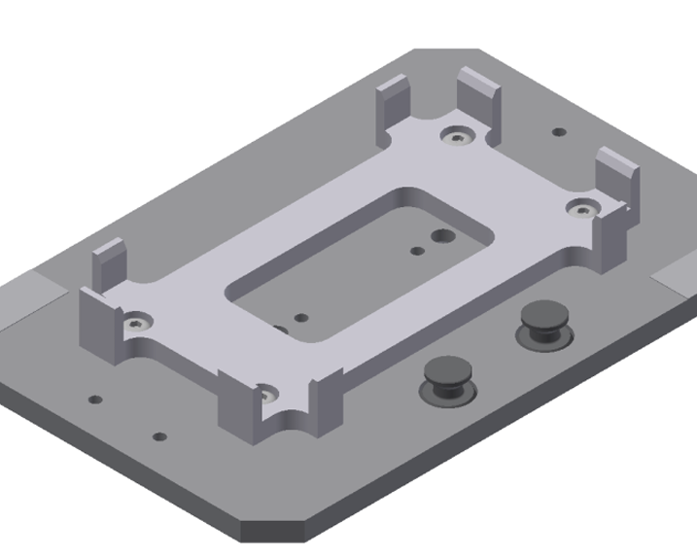
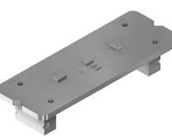
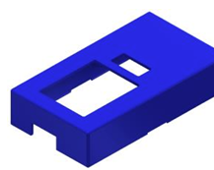
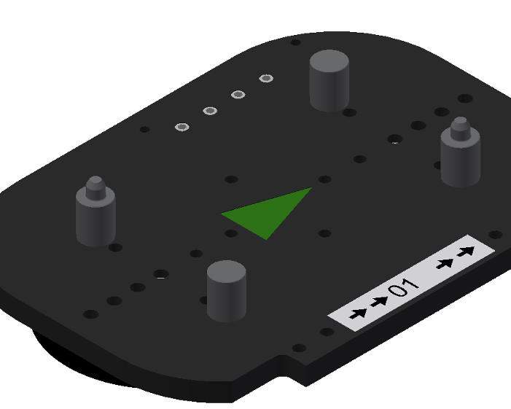
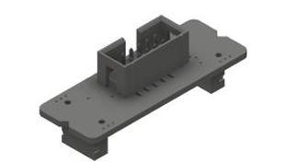

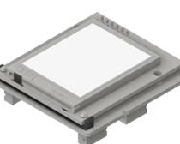
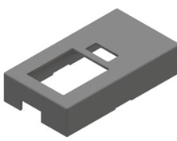
07 · SECTION 03 OF 04 · COMPONENTS & TEST METHOD · CLASSIFICATION
· 07/12
CLASSIFICATION MATRIX · 13 COMPONENTS · 3 ROUTES
Every IoT-product part has a route — none is scrap by default.
13 production components grouped by family. Each carries an explicit routing decision before disassembly begins.
HARDWARE · 5 PARTS
HOUSINGS · 5 PARTS
CARRIERS & BOXES · 3 PARTS
Reuse / Refurbish
Reuse / Recycle
Reuse (always)
Functional electronics — recovered for direct reuse if NDT passes, else refurbished.
Plastic casings — direct reuse if intact; ground for material recovery if cracked.
Logistics infrastructure — designed for many production cycles, returned to inventory.
IoT main PCB
PNo. 800
IoT back, black
PNo. 821
IoT Storage box
Mes 29
IoT Gyroscope
PNo. 811
IoT front, black
PNo. 831
Pallet
Mes 25
IoT Weather Station
PNo. 812
IoT front, blue
PNo. 832
Product Carrier
Mes 31
IoT analog PCB (0–10 V)
PNo. 813
IoT front, red
PNo. 833
NET RESULT · ZERO DEFAULT SCRAP
IoT Display
PNo. 814
IoT front, grey
PNo. 834
13 / 13 routed.
5 / 13 COMPONENTS
5 / 13 COMPONENTS
3 / 13 COMPONENTS
SLIDE 07 / 12

Slide 8
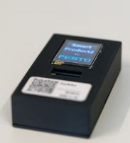
08 · SECTION 03 OF 04 · COMPONENTS & TEST METHOD · NDT
· 08/12
NDT · FUNCTIONAL ELECTRONICS · CERTIFY BEFORE RE‑ASSEMBLY
Used component are tested non-destructively,
Four real test stations already on the IoT line — each method names the parameter, the pass criterion, and the fault it catches.
NDT 01 · ELECTRICAL FUNCTIONAL
STEP 180 · 3 sec
NDT 02 · SENSOR CALIBRATION
STEP 140 · 7 sec
IoT Main PCB — connection test
Gyroscope — drift & offset
TOOL Bench power-supply 5 V/±50 mV · serial debug header
PASS Boot ACK + heartbeat within 1.0 s · current ≤ 220 mA
FAULT No-boot · dead trace · cap leakage on V_BAT
TOOL Static fixture + historical log query (step 210)
PASS Resting bias ≤ 0.05 °/s · drift < 1 °/min over 30 s
FAULT Bias creep · gimbal lock pattern · I²C ACK timeout
NDT 03 · ANALOG LOOPBACK
STEP 200 · bottleneck
NDT 04 · IDENTITY & HISTORY
STEP 50 · 1 sec
Analog 0–10 V — shield sweep
QR / matrix code — lifecycle read
TOOL DAQ + reference 0/2.5/5/7.5/10 V injection rail
PASS Linearity ≤ 0.5% FS · channel cross-talk < −60 dB
FAULT Channel saturation · gain drift · 1206 s timeout
TOOL Laser-etched data-matrix · 2D reader on RASS 1 belt
PASS ID resolves · cycle count ≤ vendor-spec · cohort match
FAULT Sticker stripped · cycle-count exceeded · cohort mismatch
SLIDE 08 / 12

Slide 9
09 · SECTION 04 OF 04 · THE WORKING SYSTEM · CLOSED‑LOOP
· 09/12
CLOSED‑LOOP ARCHITECTURE · HEALTH‑SCORE ROUTING
Return. Test. Decide. Re-inject.
A returned product runs through one decision diamond. Health score determines its route — and a routed component does not leave the line.
STAGE 01
STAGE 02
STAGE 03 · NDT
STAGE 04 · DECISION
STAGE 05 · RE‑INJECT
Customer return
Non-destructive disassembly
Component testing
Health score → route
REUSE → assembly inventory, no extra work
→
→
→
→
REFURB → repair sub-parts, re-test, certify
End-of-life IoT product enters via the dismantle station inbound buffer.
Human-assisted dismantle station separates PCB, sensors, display, housing.
Four-station functional NDT computes a health score, 0–100.
≥ 85 → Reuse
50–84 → Refurbish
< 50 → Recycle
RECYCLE → material separation → supplier
↑
Personalised RE-assembly and customer acquisition
WHY THIS LOOP ACTUALLY CLOSES
The decision diamond runs on measured NDT data, not only on visual inspection — so the routing is well tested for the next assembly.
SLIDE 09 / 12

Slide 10
10 · SECTION 04 OF 04 · THE WORKING SYSTEM · CYCLE DATA
· 10/12
MEASURED CYCLE DATA · 24 STEPS · 27 AUG 2022
BASELINE KPI
62.5% of steps run at or below the 30s optimum.
15
9
EFFICIENT STEPS
OVER OPTIMUM
1,206s
24
PEAK BOTTLENECK
TOTAL STEPS
STEP · DESCRIPTION
DURATION (s) · ■ ≤30s ■ >30s ─ 30s optimum
SECONDS
10
release on stopper 1
30s optimum
14
20
place cover RASS1
31
30
assemble MAIN PCB RASS1
55
40
switch on PCB
13
50
read QR RASS1
1
60
assemble DISPLAY RASS1
35
70
move pallet RASS1
51
80
measure analog
2
90
place cover RASS2
29
100
assemble ANALOG RASS2
59
110
assemble GYROSCOPE RASS2
34
120
move pallet RASS2
51
130
check analog
5
140
check gyroscope
7
150
place cover RASS3
28
160
assemble FRONT COVER RASS3
32
170
move pallet RASS3
22
180
test IoT PCB connection
3
190
test touch display
6
200
test analog I/O shield ← BOTTLENECK
1,206
210
check gyroscope history
23
230
print label
10
240
deliver part
10
250
store from stopper 2
19
SLIDE 10 / 12

Slide 11
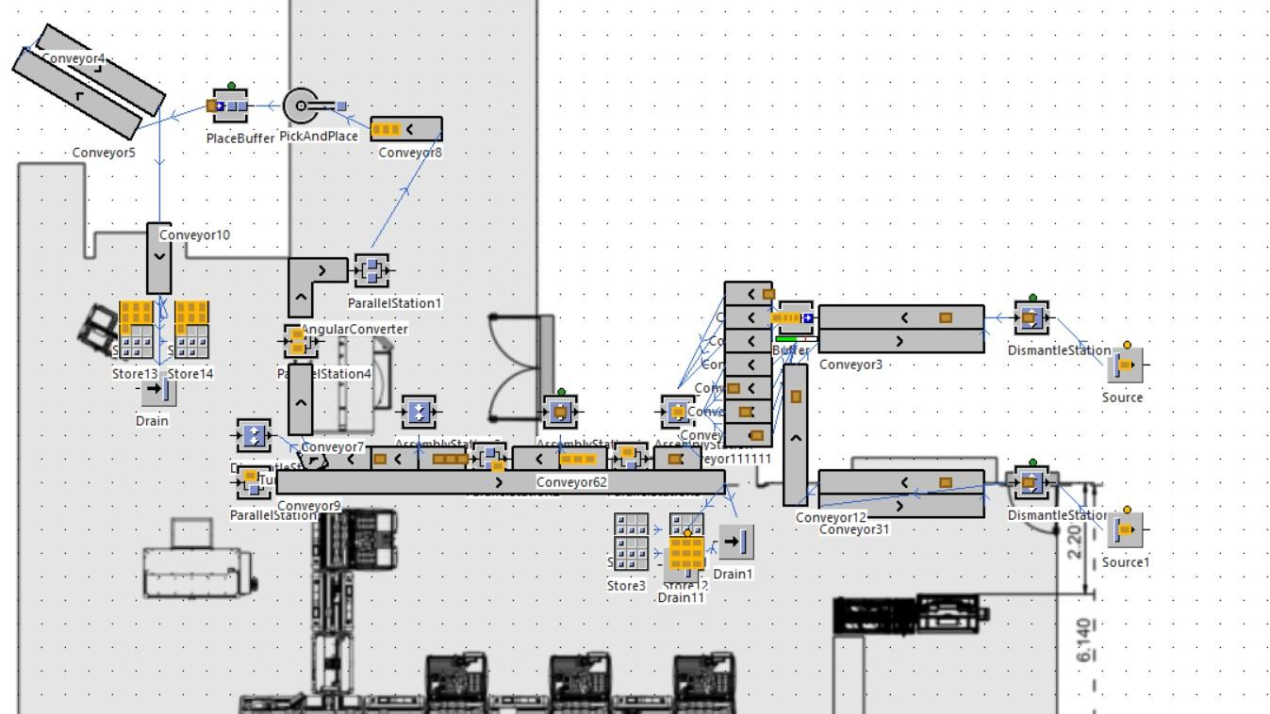
11 · SECTION 04 OF 04 · THE WORKING SYSTEM · SIMULATION
· 11/12
PLANT SIMULATION · SIEMENS TECNOMATIX · LIVE LOOP
The demonstrator runs the loop end-to-end in simulation.
PROCESS FLOW · 5 STAGES
Source → Reassembly
01 SOURCE
Entry of returned/end-of-life products into the model
02 HUMAN TESTING STATION
Inspect condition · trigger dismantle decision
03 DISMANTLE STATION
Human-assisted disassembly into constituent parts
04 SORTING \ BUFFER
Sensor-distributed conveyors route components
05 REASSEMBLY
Certified parts feed the new-product assembly stations
OUTCOME
The loop closes in simulation — ready for line trial.
MODEL OVERVIEW · SOURCE \ CONVEYORS \ Assembly STATIONS \ DISMANTLE STATIONS \ DRAINS
SLIDE 11 / 12

Slide 12
· 12/12
Thank you. ♻️
Five minutes for questions — happy to dig into FMEA, NDT, routing, or simulation details.
REUSE
REFURBISH
RECYCLE
LEAD Denis Gabriela L. Esquivel
Favour Atem · Barbara Calderón · Anshpreet Singh · Marko A. García · Diego Cárdenas

